Slide 1
Exploring the Association Between ZNF175 and Hearing Loss By Expanding Rare Variant Gene Burden Analyses to Penn Medicine Biobank v4 Data
Analysis Plan Draft
Elena Sretenović, Week 5, 7/1/26
Notes:
Possible Titles:
Re-evaluating the Association Between ZNF175 and Hearing Loss Using Penn Medicine Biobank v4 Exome Data
Expanding Rare Variant Gene Burden Analyses to the Latest Penn Medicine Biobank Exome Release
Replication of the ZNF175 Hearing Loss Association in the Penn Medicine Biobank v4
Assessing the ZNF175 Hearing Loss Signal in an Expanded PMBB Cohort
Chasing the ZNF175 Signal: Extending Rare Variant Gene Burden Analyses to Expanded PMBB Cohort

Slide 2
Background: What Has Been Done
 | 2021 Park Paper | 2023 Hui Paper
Study Design | Genome first, rare variant ExWAS | Gene burden + GWAS
Dataset | ~11K exome | ~44K exome
Variants Included | Rare pLOF variants | Rare pLOF variants and missense REVEL > 0.6
Phenotypes | Electronic Health Records (EHR) (Phecode 388 for tinnitus and Phecode 389 for hearing loss) | Audiogram hybrid hearing loss (not just phecodes)
Covariates | age + age² + sex + PC1-10 | age + age² + sex + PC1-20
ZNF175? | The paper was not just hearing loss focused, but it Identified genes associated with hearing loss and tinnitus First appearance of ZNF175 Association between ZNF175 and tinnitus (and almost hearing loss) ZNF175 and tinnitus → p = 3.24 x 10^-10 (genome wide bar is now p < 5x10E-8 , so this is very significant) This association was replicated in BioMe, DiscovEHR and UKB | Recovered known hearing loss genes and novel candidates Loss of ZNF175 signal The ZNF175–tinnitus signal had decayed below the discovery threshold The Chapter 1 Replication Pipeline was based on this paper
Notes:
Park: Andre Rico slides lo
And
Each disease phenotype was tested for an association with each gene burden or single variant using a logistic regression model adjusted for age, age squared, sex and the first ten principal components (PCs) of genetic ancestry. l
Hui: We regressed degree HL on the burden count, defined as the total number of predicted deleterious variants in known HL genes including sex, age, age² and 20 genomic principal components as covariates, and find that degree HL is associated with burden count (β = 4.8×10⁻³ per-variant, p = 0.03, Table 1).

Slide 3
Background: What Andre Has Done
Performed Park’s pipeline identically on both PMBB cohorts (~11K exome and ~44K exome)
Asked whether carrier status of ZNF175 predict disease (tinnitus)
Variants Included | pLOF MAF ≤ 0.1%
Phenotypes | tinnitus (ICD 388.3x / H93.1x, rule-of-2) Rule-of-2: A person is considered a case only if the diagnosis appears at least twice in the electronic health record.
Covariates | logistic ~ carrier + age + age² + sex + PC1–10, EUR/AFR-stratified + meta the analysis was run separately for different populations ancestry-specific results were combined through a meta-analysis

Slide 4
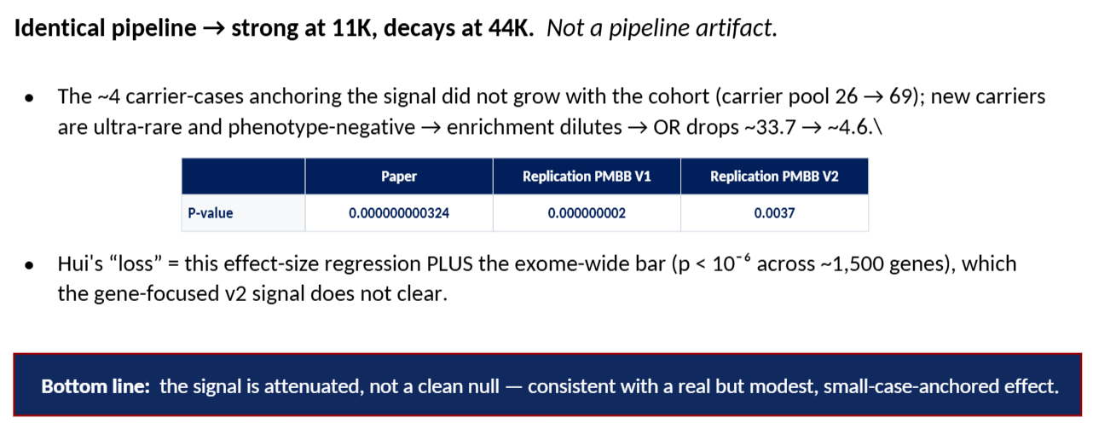
Andre’s Slides

Slide 5
My Project
What are the perceived gaps in the field/knowledge
  The Park pipeline analysis has not been run on the latest PMBB data (~70K exomes, v4)
  It is still not known whether the original ZNF175 association is a false positive or if it reflects a real biological effect that is only detectable in a small subset due to potential interactions with environmental factors or other genes
What question are you answering in this experiment/analysis?
  Why does the ZNF175 signal weaken in larger cohorts? Will the signal disappear entirely with the v4 PMBB data?
What is your hypothesis? If not specifically hypothesis driven, what do you expect to find and why?
  Based on the meeting notes and previous discussions, I hypothesize that ZNF175 contributes to hearing loss but acts through a digenic inheritance model rather than a single-gene mechanism. If this hypothesis is correct, expanding the cohort would dilute the overall signal because many newly added ZNF175 carriers would not carry the required modifier factors. However, inspecting the new individuals who are ZNF175 carriers and have hearing loss could yield clues into what other genes are at play here.

Slide 6
Data Collection
Dataset
  Human participants (PMBB data)
  The current v4 release includes ~70K samples
  Final sample size will likely depend on QC filtering
Hearing Loss Phenotypes
  Question: What phenotypes should I include?
Only HL
or
both HL and tinnitus?
Phecodes (binary phenotype
or
audiograms (continuous phenotype)?

Slide 7
QC
1.
2.
PMBB QC
Begin with PMBB v4 exomes. Restrict analysis to samples passing PMBB quality control.
PMBB data has already undergone QC prior to the release of v4.
I will export the phenotypes and covariates in the same file, and then exclude the samples based if the phenotype or covariate information is missing.
Choose High Quality Variants
Restrict analyses to rare variants meeting the quality thresholds defined in the previous studies
Genotype Call Rate
  Exclude variants with genotype call rate <99%
  Monitor how many variants are removed after filtering
  If a large number of variants are dropped, I will report this to Nikki (but a substantial drop is not expected)
Hardy-Weinberg Equilibrium (HWE)
  Use p-value threshold of 10⁻⁶
  Perform HWE filtering using PLINK 1.9 (not PLINK 2.0)
  Include HWE filtering in SAIGE Step 1 QC procedures
MAF Thresholds
  Use 0.0001, 0.001, and 0.01
  Test all three MAF thresholds
  Report how many variants remain after each threshold

Slide 8
QC
3.
Category | Definition / Criteria | Source
pLOF (predicted loss-of-function) | Frameshift, stop-gained, start-lost, stop-lost, or splice-site variants (SpliceAI >= 0.2) | VEP Consequence + SpliceAI
pDM (predicted damaging missense) | Missense variants classified as likely_pathogenic by AlphaMissense | AlphaMissense
AMB (ambiguous missense) | Missense variants with AlphaMissense 0.34-0.564 | AlphaMissense
LB (likely benign missense) | Missense variants with AlphaMissense < 0.34 | AlphaMissense
Other | Remaining variants not meeting any of the above criteria | VEP Consequence
Combined (e.g., pLOF ; pDM) | Union of categories for joint burden testing | -
Classify Variants
Classify variants using:
pLOF
Predicted loss-of-function variants
Missense
AlphaMissense
  Missense variants classified using AlphaMissense
REVEL
  Missense variants classified using REVEL score
  Confirm final REVEL threshold with Nikki (either 0.5 or 0.05).
Nikki’s Chart

Slide 9
QC
4.
5.
Compare Missense Classification Methods
Compare how many missense variants are captured by
  AlphaMissense
  REVEL
Determine overlap and differences between the two approaches
Report counts for each annotation category
  List all variants contributing to significant genes
  Report:
    Total variants
    Number of pLOFs
    Number of AlphaMissense variants
    Number of REVEL variants
Decide whether to use AlphaMissense or REVEL missense variants
Define Which Variants Will Be Used in the Burden Test
Depending on the classification of the missense, choose whether to include the missense variants in the study or whether to just focus on pLOFs

Slide 10
QC
6.
7.
Ensure High Quality Covariates
To ensure high quality of covariates like age, sex, and genetic principal components (PCs), I will investigate them for unexpected values or inconsistencies prior to their incorporation in subsequent SAIGE analysis
Even though the PMBB team did do a check for these variables, I will still verify to avoid inconsistencies
Analyze age for missing values or implausible values
Analyze sex for missing coding and agreement with genetic sex
Analyze principal components for completeness
Check If Sufficient Cases vs Controls
Review hearing loss phenotype frequencies and confirm that there are enough cases and controls for the analysis
Obtain and report case/control counts for each phenotype
If there are enough cases, I will generate separate case/control counts for EUR and AFR cohorts as well.
When samples are removed due to missing phenotype information, report how many are dropped and tell Nikki
8.
Check Gene Carrier Threshold
Verify that the genes meet the minimum carrier thresholds

Slide 11
Analysis
1.
SAIGE-GENE: Step 1, Create Null Model
This step creates a model that tests what explains the phenotype WITHOUT looking at specific variants.
Use call-rate thresholds shown in Nikki's reference figure
Use pre-calculated PCs
  Use the PCs that are calculated for the population being using.
    If using EUR and AFR combined, the PCs need to have been calculated with these populations
    If stratified, use EUR PCs for EUR and AFR PCs for AFR
  I will use a variance explained plot to determine how many PCs should be used as covariates → this number will most likely be 4 or 5
    The PMBB SAIGE pipeline (the one on the PMBB github) keeps only 4 PCs
Perform LD Pruning (Linkage Disequilibrium Pruning)
  Question: Check with Nikki if this is a necessary step (if using prior PCs, this may not be needed)
  ld_window = 1080
  ld_r2 = 0.3
    Verify all pruning parameters with Nikki

Slide 12
Analysis
2.
SAIGE-GENE: Step 2, Test Rare Variant Gene Burden Test
Given the null model, this steps tests whether variants in a gene explains additional variation.
Variants are grouped based on what gene they affect → this information is put into the group file
Use these Inputs:
Model file
  the fitted null model (all parameters from Step 1)
Genotype/dosage file
  the actual variant data you want to test.
  Formats: PLINK (.bed/.bim/.fam), BGEN (used by UK Biobank), VCF, or BCF.
Group file
  a file that defines sets of variants, typically grouped by gene or genomic region, along with annotation labels (e.g. loss-of-function, missense) and user-defined weights per variant.
SKAT (Sequence Kernel Association Test)
  a variance component test that allows variants in the same gene to have different directions and sizes.
  More flexible but less powerful when effects are truly unidirectional.
Repeat with different masks to define subsets of variants within a gene
  MAF thresholds of 0.0001, 0.001, and 0.01
Examine the differences in burden between cases and controls
Evaluate the carrier counts for ZNF175 and other genes of interest
  Question: Should I consider all genes or just an adjudicated list of hearing loss genes?

Slide 13
Planned Interpretation and Visualization of Results
I will evaluate statistical significance using p values generated from the PMBB v4 analysis.
Use Bonferroni significance: alpha (0.05)/# of tests)
I will compare my results against published findings and results from analyses of previous PMBB releases.
VIsualization
QQ Plots
  Checks for systemic bias
Modified Manhattan Plots
  Looks at genes on x axis rather than just individual variants

Slide 14
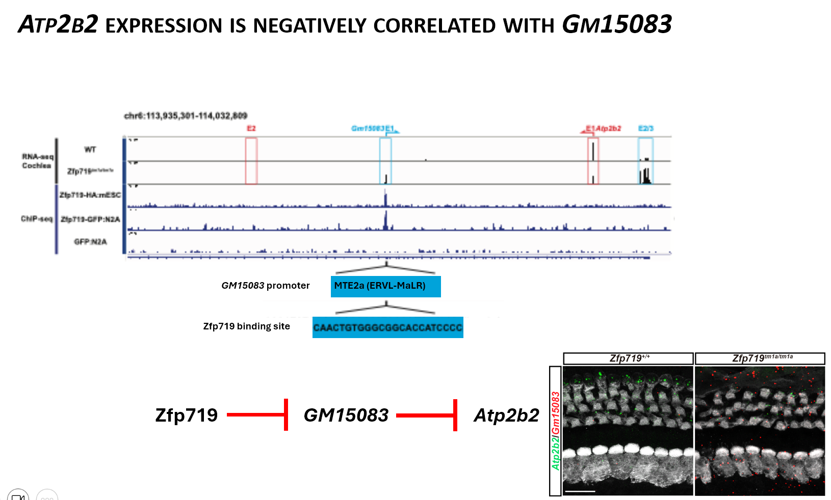
Possible Other Directions
Considering the Digenic Model
  See what samples have pLOF variants in ZNF175 but DON’t have the phenotype of hearing loss or tinnitus → then see what other genes have pLOF variants
  This can help elucidate the mechanistic pathway
Considering the Immune Role
  ZNF175 seems to play a role in HIV stuff
    “ZNF175 expression is heavily upregulated in brain macrophages and microglia during neuroinflammatory events (like HIV encephalitis)
  Could this be correlated with HL (considering that immune cells DO play a role in preventing further HL)?
  ??
Considering gene x environment
  This is difficult to do
  Maybe instead of environment, we could consider other inflammation in the body (what other phenotypes the patient came in with)

Slide 15
  Question: Is it incorrect to say that the signal decays? (Andre analysis)
  Question: What phenotypes should I include? (tinnitus, HL, only audiograms or only phecodes?)
  Question: Check with Nikki if LD pruning is a necessary step (if using prior PCs, this may not be needed) (because it is done before PCA normally)
  Question: Should I consider burden on all genes or just an adjudicated list of hearing loss genes?
  Question: What is Bonferroni significance
  Question: Title for poster lol

